Slide 1
TEACHERS’ INFORMATION SEMINAR: FEEDBACK
LEENA M. IILEKA
VAN RHYN P.S.

Slide 2
Objectives:
capacitating teachers in subject areas,
sharing classroom teaching skills and methodologies amongst others.
Improve teachers presentation skills

Slide 3
ABSTRACT
The seminar by two clusters (Plato and Freud)
3rd - 4th of October at Van Rhyn P.S.
Nineteen (19) teachers from eight (8) primary schools
One (1) student teacher
Various presentations; (high institutions and companies)
Evaluation form – feedback: suggested to continue annually, days to be extended, presentation time to be extended, etc.

Slide 4
Schools attended
19 teachers from eight (8) primary schools namely;
Van Rhyn PS,
Namutuni PS,
Michelle Mclean PS,
Eros PS,
Green Leaves PS,
Faith CS,
Moses Van Del Byl PS
Bethel PS.
student teacher from IUM heard

Slide 5
Presenters
Mr Lewin, KDDoAC
Mrs Mhopjeni, MME/UNESCO representative
Mrs A. Amoomo, Internet Society
Mr Hitila, Mr Tjakwanda, Prof. Onjefu, (all from NUST)
Mr Haihambo from UNAM
Mr Mulundileni from Mindsinaction who presented on “ The Significance of Technology at Young Age”.
Mr De Wet and Mr Mario - motivational speakers.

Slide 6
Activities
Mindsinaction - practical robotic activity.
Visitation to Meteological service – collection of weather forecast.
The Ministry of Mines and energy – laboratory and museum

Slide 7
Financial Report
School | No. of teachers | Total Amount paid
Van Rhyn P. S | 4 teachers x N$250.00 | N$1 000
Namutuni P.S. | 8 teachers x N$250.00 | N$2 000
Michelle Mclean P.S | 3 teachers x N250.00 | N$ 750
Green Leaves | 1 teacher x N$250.00 (cash) | N$ 250
Total Amount received |  | N$4 000

Slide 8
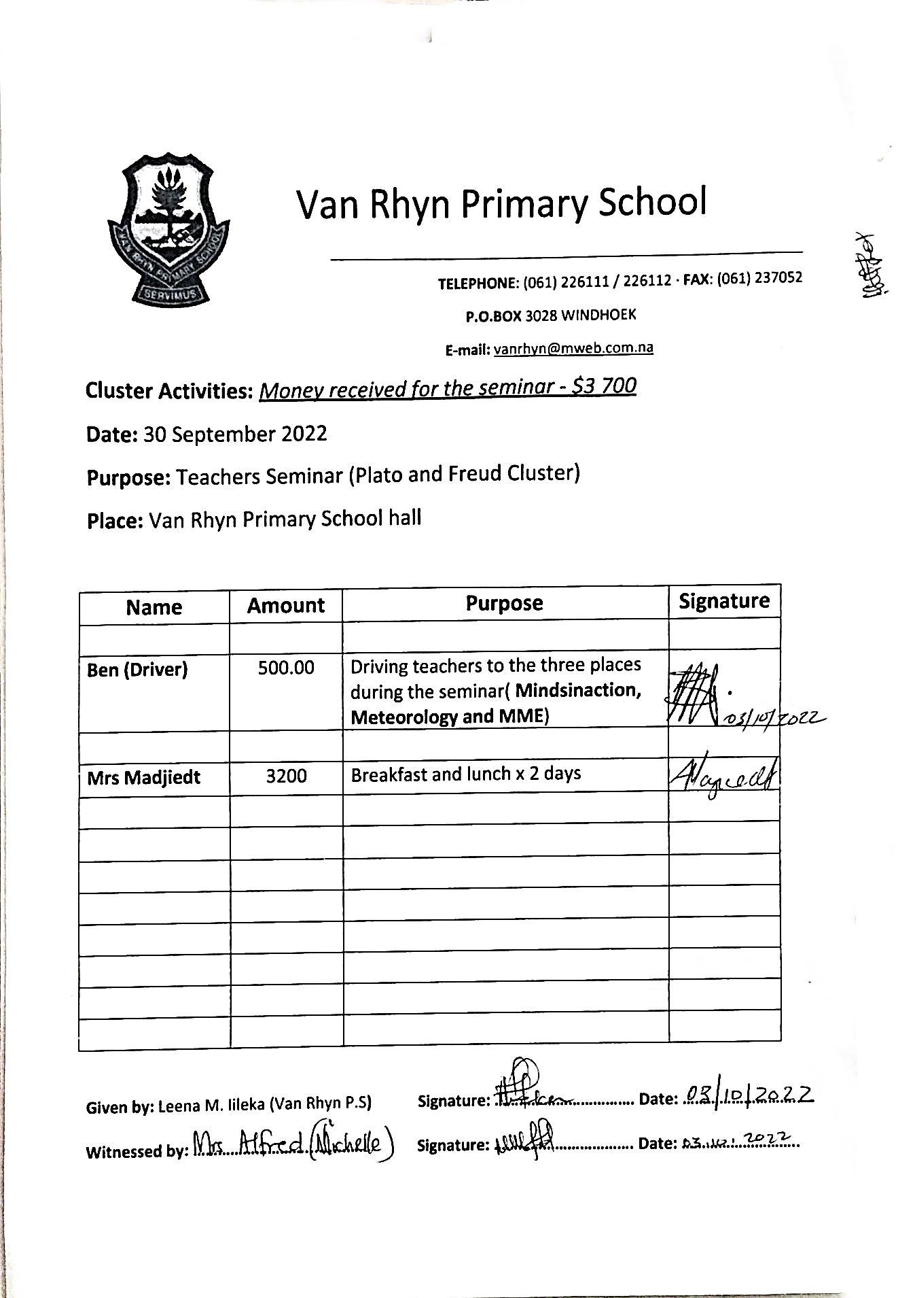
Money paid to the recipients

Slide 9
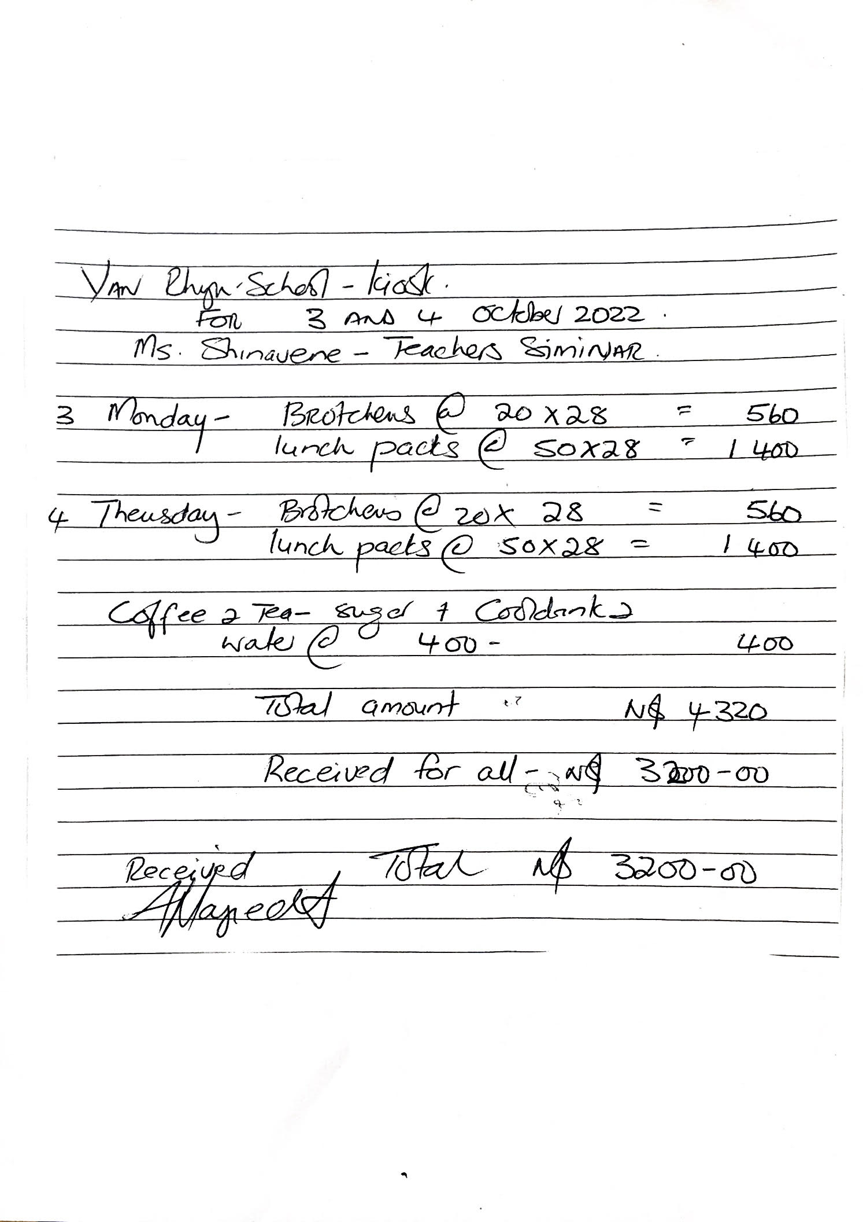
Menu costs

Slide 10
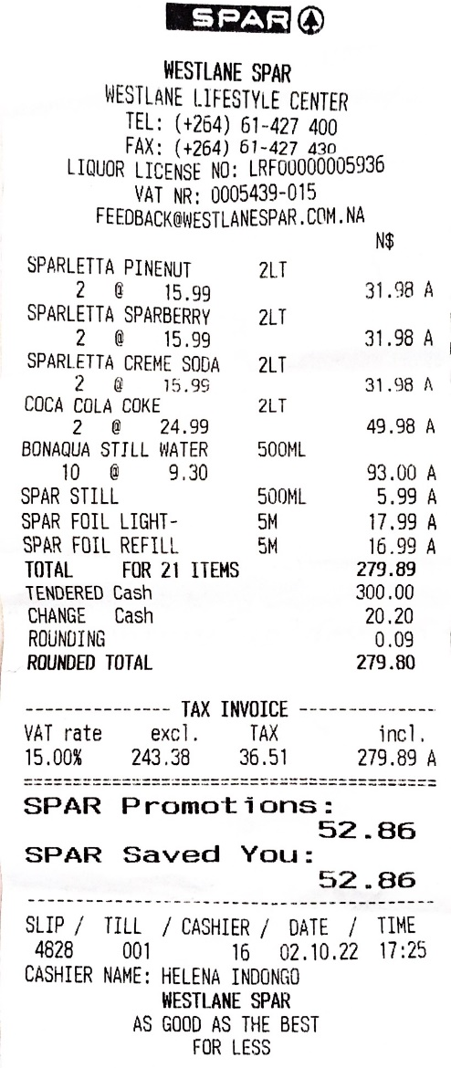
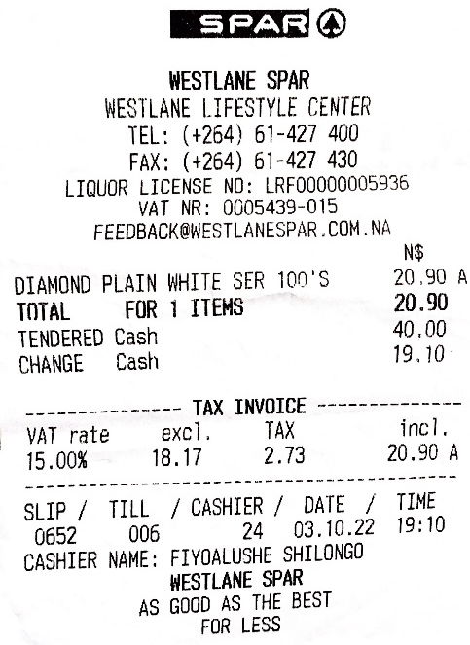
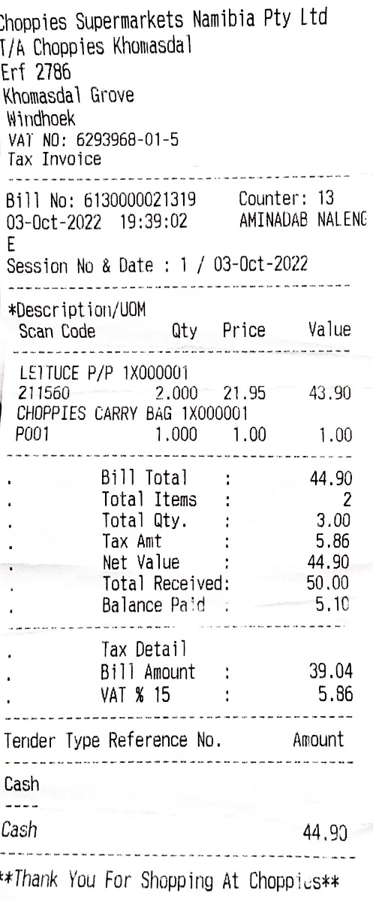
Money received in cash overran to an amount of 94.80

Slide 11
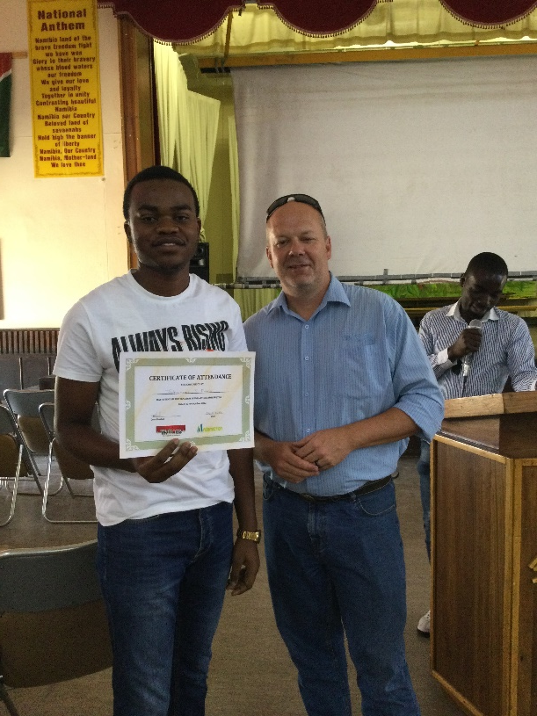
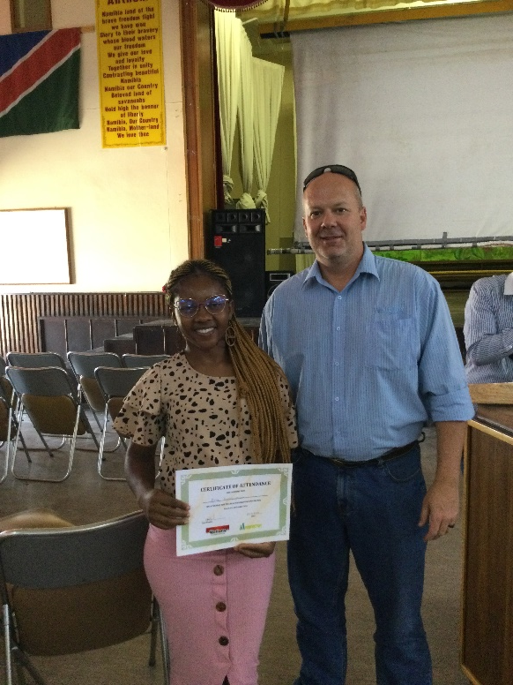
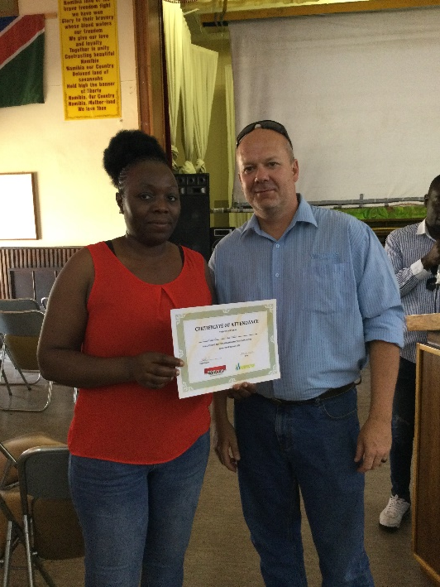
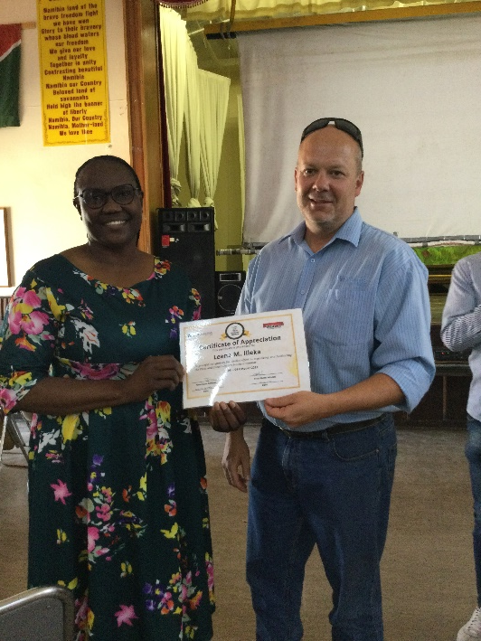
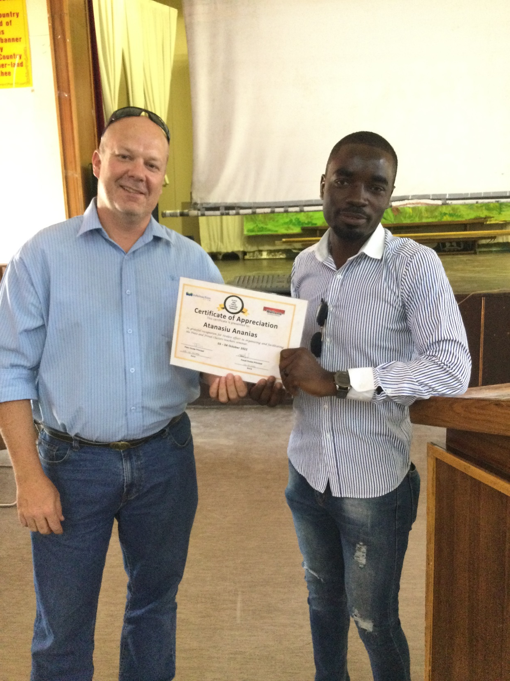
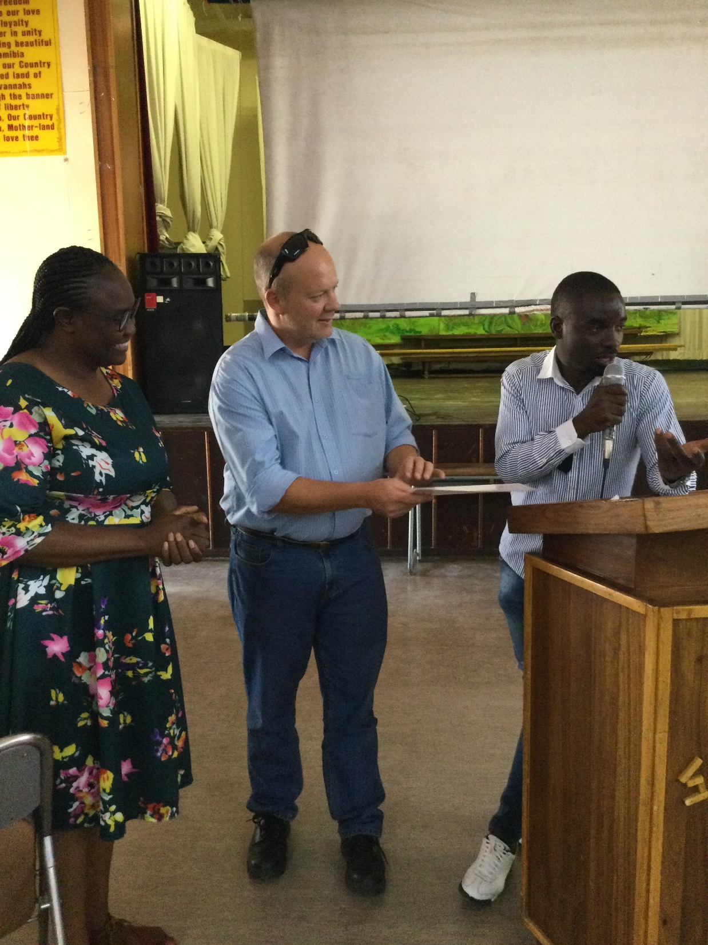
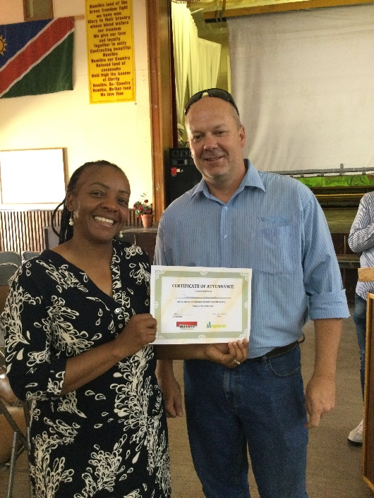
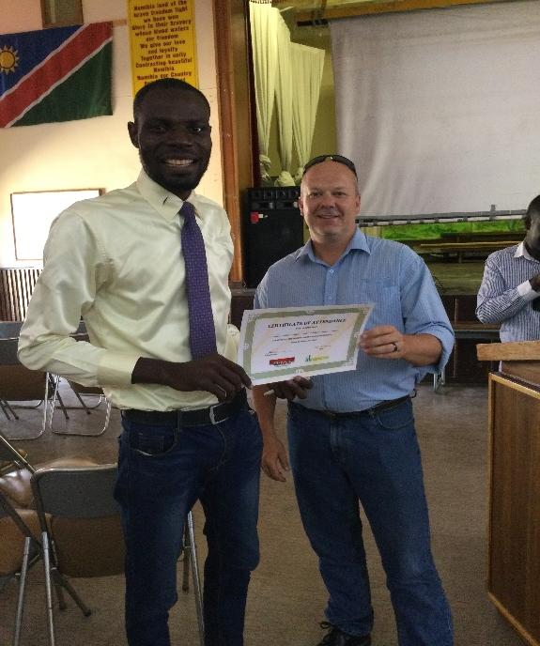
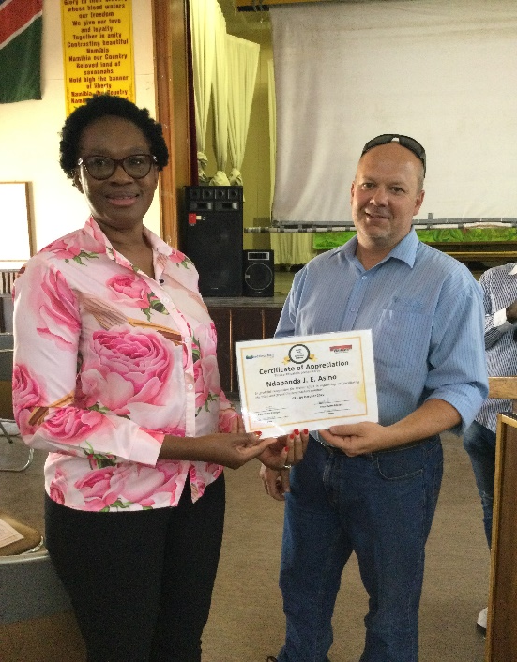
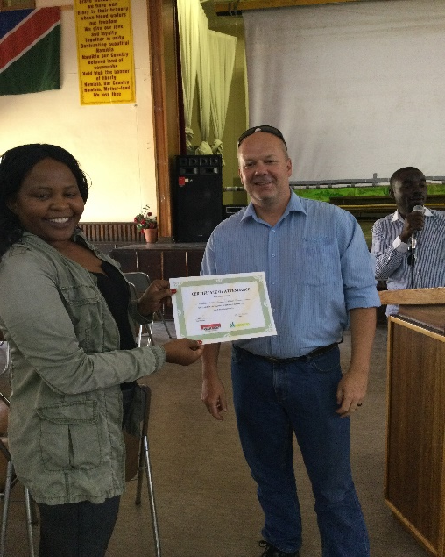
End of the seminar

